Slide 1
V-Menu
Team Two

Slide 2

TEAM Members
Matthew Boyette – Lead Developer
David Hughes – Lead Designer
William Mejia – Developer
Demetrius Myers – Developer
Slaven Popadic – Developer

Slide 3
Client-Server Trade Offs
- User devices will need wireless internet access to reach the server; either WiFi or a data plan. Restaurant owner may wish to provide free WiFi access to mitigate this risk.
- Performance can be a serious issue if the server is under heavy load due to bottleneck. Likewise, there is a single-point of failure; if the server goes down, application is useless. Restaurant owner may wish to invest in a cloud-computing platform such as Amazon’s AWS or Microsoft’s Azure to spin up multiple server instances for load balancing and redundancy to mitigate this risk.
- All non-trivial operations must be performed server-side; performing operations on the client-side represents a security risk. In our case, clients are nothing more than internet browsers; therefore the client’s only responsibility is to render content.
- Restaurant owner may wish to invest in dedicated IT personnel to perform regular basic maintenance duties.

Slide 4
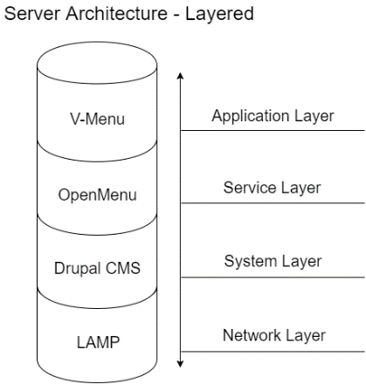

Slide 5
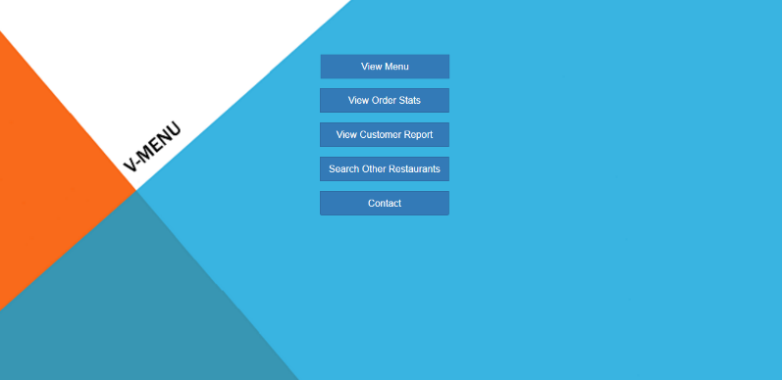
Main menu

Slide 6
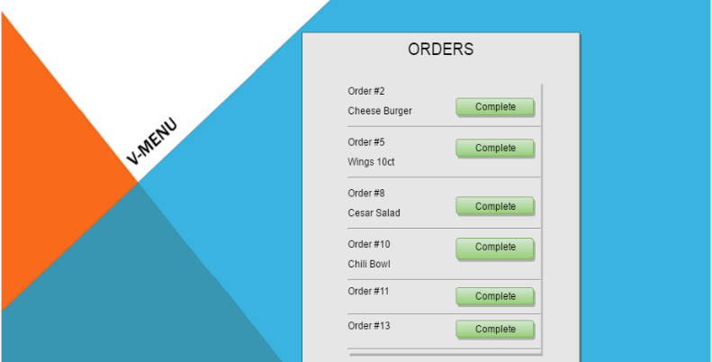
Kitchen view

Slide 7
Manager View

Slide 8
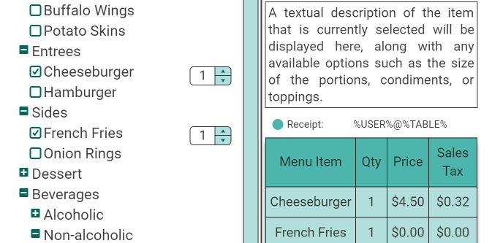
Example of order menu

Slide 9
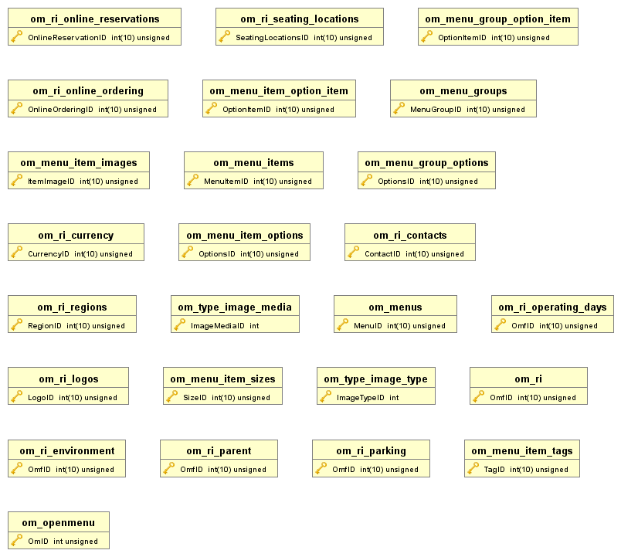

Slide 10
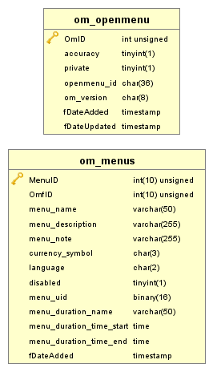

Slide 12
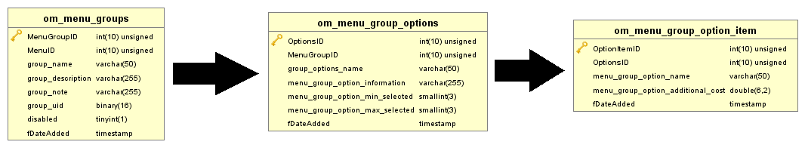

Slide 13
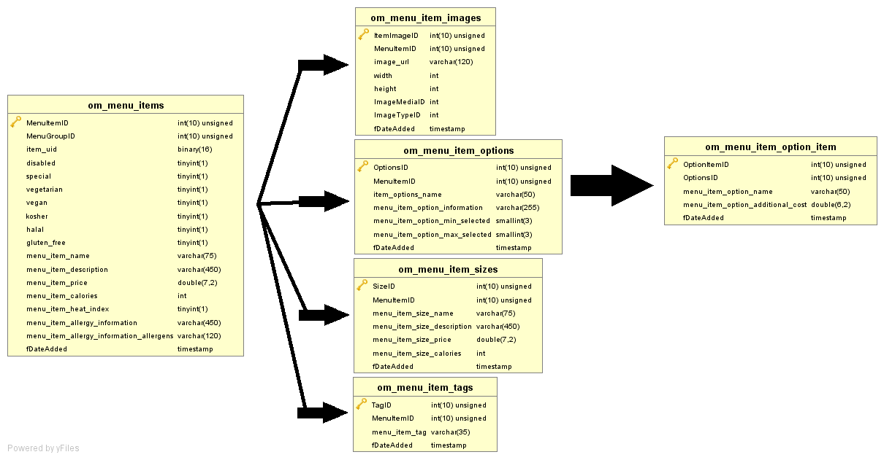

Slide 14
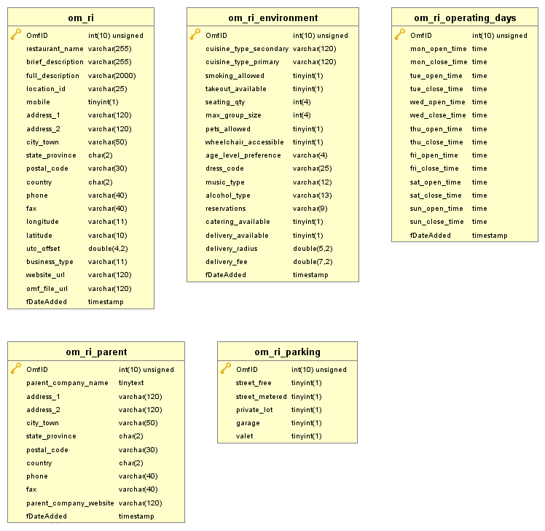

Slide 15
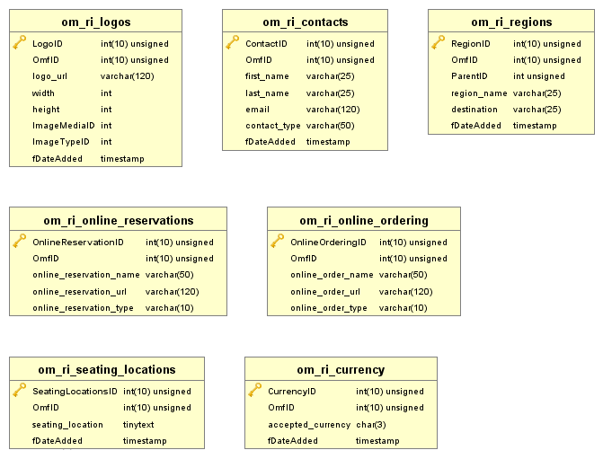

Slide 16
